Slide 1


VARDHAMAN COLLEGE OF ENGINEERING
(AUTONOMOUS)
Affiliated to JNTUH, Approved by AICTE, Accredited by NAAC with A++ Grade, ISO 9001:2015 Certified Kacharam, Shamshabad, Hyderabad – 501218, Telangana, India
DEPARTMENT OF COMPUTER SCIENCE AND ENGINEEERING (AI&ML)
21CSM-CP-10

Slide 2
Innovative Approaches to Blood Flow Monitoring using Sensor Data.

Slide 3













Slide 4




Slide 5






Slide 6





Slide 7

Abstract

Slide 8



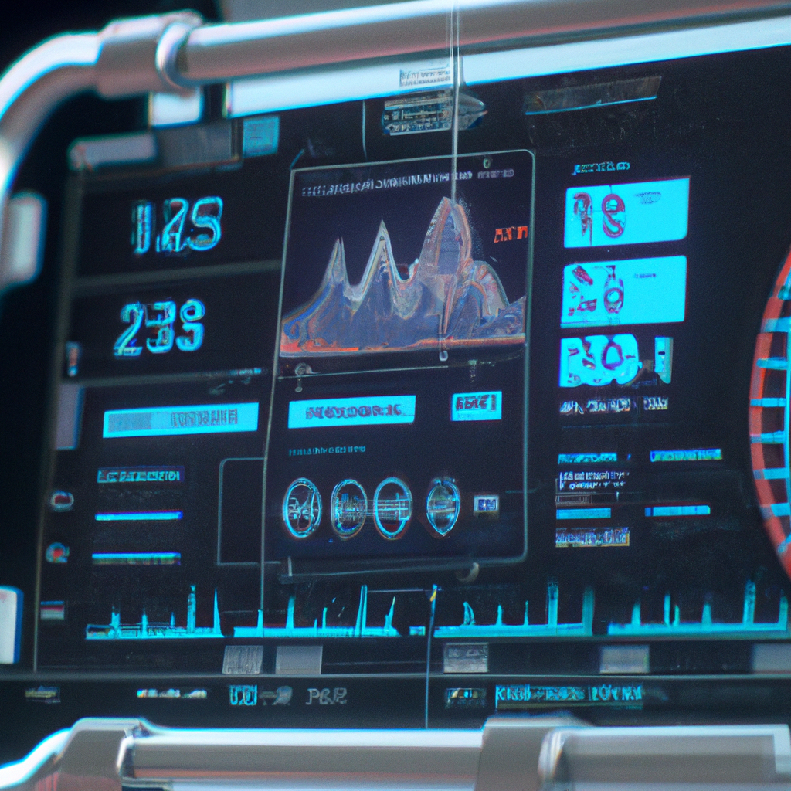

Abstract
Blood flow detection and monitoring are crucial aspects of medical diagnosis and treatment. Numerous techniques have been developed over the years to measure and monitor blood flow. Sensory data plays a vital role in the detection and monitoring of blood flow, and various sensors are now available to detect blood flow. This literature survey provides an overview of existing techniques and methods for blood flow detection and monitoring using sensory data.
Introduction

Slide 9

Objectives

Slide 10

Objectives
Objective 1: Data Collection and Preprocessing
Collect and curate a comprehensive dataset of sensory data related to blood flow, including Doppler ultrasound measurements, pressure recordings, and other relevant vascular signals. Clean and preprocess the data to remove noise, handle missing values, and ensure consistency for accurate analysis.
Objective 2: Feature Extraction and Engineering
Identify and extract relevant features from the sensory data that capture the essential characteristics of blood flow patterns. Utilize domain knowledge and signal processing techniques to transform raw data into informative features, such as velocity profiles, frequency components, and waveform attributes.
Objective 3: Model Selection and Development
Choose suitable machine learning algorithms for blood flow detection and monitoring, considering the nature of the data and the problem. Develop and train predictive models, such as Random Forest, Support Vector Machines (SVM), or neural networks, to learn the relationships between the extracted features and different blood flow conditions.
Objective 4: Anomaly Detection and Classification
Implement algorithms for anomaly detection to identify deviations from normal blood flow patterns. Train the models to classify different flow patterns, including normal, restricted, turbulent, and blocked flows. Ensure the models can distinguish between various types of vascular conditions.
Introduction

Slide 11
Objectives
Objective 5: Real-time Monitoring and Visualization
Design a system for real-time blood flow monitoring using the trained machine learning models. Integrate sensory data streams into the system to continuously assess blood flow patterns. Develop visualizations and dashboards that display real-time insights, providing healthcare professionals with immediate feedback on vascular health.
Objective 6: Performance Evaluation and Validation
Evaluate the performance of the developed models using appropriate metrics such as accuracy, precision, recall, and F1-score. Employ cross-validation techniques to validate the models' generalization abilities. Fine-tune hyperparameters to optimize model performance.
Objective 7: Clinical Integration and Interpretability
Integrate the developed system into clinical settings, collaborating with healthcare professionals to ensure usability and relevance. Enhance the interpretability of the models by generating feature importance rankings and visual explanations, enabling clinicians to understand the basis of predictions.
Objective 8: Continuous Improvement and Adaptation
Establish a feedback loop for continuous improvement. Monitor the system's performance in real-world scenarios, collect feedback from healthcare practitioners, and update the models as needed to adapt to changing patient conditions and improve accuracy.
Introduction

Slide 12

Literature Survey

Slide 13

Literature Survey
s.no | Title of the paper | Advantages | Disadvantages
1 | Arterial Blood Flow Sensor | 1.Non-invasive and painless 2. devices to measure the pulse waves in areas rich in arterio-venous anastomoses, such as the fingers, toes, earlobes, or some regions of the face. | 1.Cannot differentiate between arterial and venous blood flow 2.Limited depth of penetration
2 | IoT Based Continuous Monitoring and Measurement of Pulsatile Blood Flow: A Review | 1.This system's main concept is to provide a cost effective, secure, simple and automated controlling and flow monitoring that can be easily implemented in any hospital and can be easily controlled by nurses and can control the flow rate from a distance. 2.wireless (connected wifi orbluetuth) | 1.But an external person/nurse is required to monitor patient, even from the distance
3 | Non-Invasive Blood Flow Speed Measurement Using Optics | 1.High temporal resolution 2.Can measure blood flow speed in small areas 3.Can detect low flow velocities | 1.There are few such methods efficient than this method 2.Limited penetration depth 3.Sensitive to movement artifacts and ambient light
4 | Blood Flow Detection and Monitoring Using Sensory Data | 1.To sense data using smartphones or laptops which uses sensors to sense and then amplify and filter the data that can be transmitted toa portable device for analysis. 2.Wearables that are used to collect data and analysed for the betterment of the health | 1.This paper does not introduce any software to analyse the data collected 2.It also doesn’t discuss about Accuracy of the data collected
Introduction

Slide 14
Literature Survey
"Real-time Blood Flow Monitoring using Smart Sensing System" by K. Karunanithi and S. Kannan, published in Procedia Computer Science in 2015, presents a system for monitoring blood flow using a smart sensing device that measures the pulse wave velocity and blood volume changes. The authors use a combination of photoplethysmography (PPG) and impedance plethysmography (IPG) to measure blood flow in real-time.
"Continuous Non-invasive Blood Pressure and Blood Flow Monitoring using a Wearable Sensor" by Y. Wang et al., published in IEEE Journal of Biomedical and Health Informatics in 2016, describes a wearable sensor that can measure blood flow velocity and blood pressure non-invasively. The authors use a combination of PPG and accelerometry to detect blood flow and motion artifacts, and a machine learning algorithm to estimate blood pressure.
"A Wearable Sensor System for Real-Time Blood Flow Monitoring" by S. Lee et al., published in Sensors in 2020, presents a wearable sensor system that uses an accelerometer and a photoplethysmography sensor to measure blood flow and blood pressure non-invasively. The authors use a deep learning algorithm to predict blood flow and blood pressure based on the sensor data.
"Smartphone-based Blood Flow Monitoring System for Remote Patient Monitoring" by J. Kim et al., published in Journal of Medical Systems in 2021, describes a smartphone-based blood flow monitoring system that uses a smartphone camera and a finger sensor to measure blood flow and oxygen saturation. The authors use a machine learning algorithm to predict blood flow and oxygen saturation based on the sensor data.
"Wearable Sensor System for Monitoring Peripheral Blood Flow" by M. Rahman et al., published in Sensors in 2021, presents a wearable sensor system that uses an array of PPG sensors to measure blood flow non-invasively. The authors use a machine learning algorithm to predict blood flow based on the sensor data and demonstrate the feasibility of the system for monitoring peripheral blood flow in different body positions.
Introduction

Slide 15

Problem statement

Slide 16
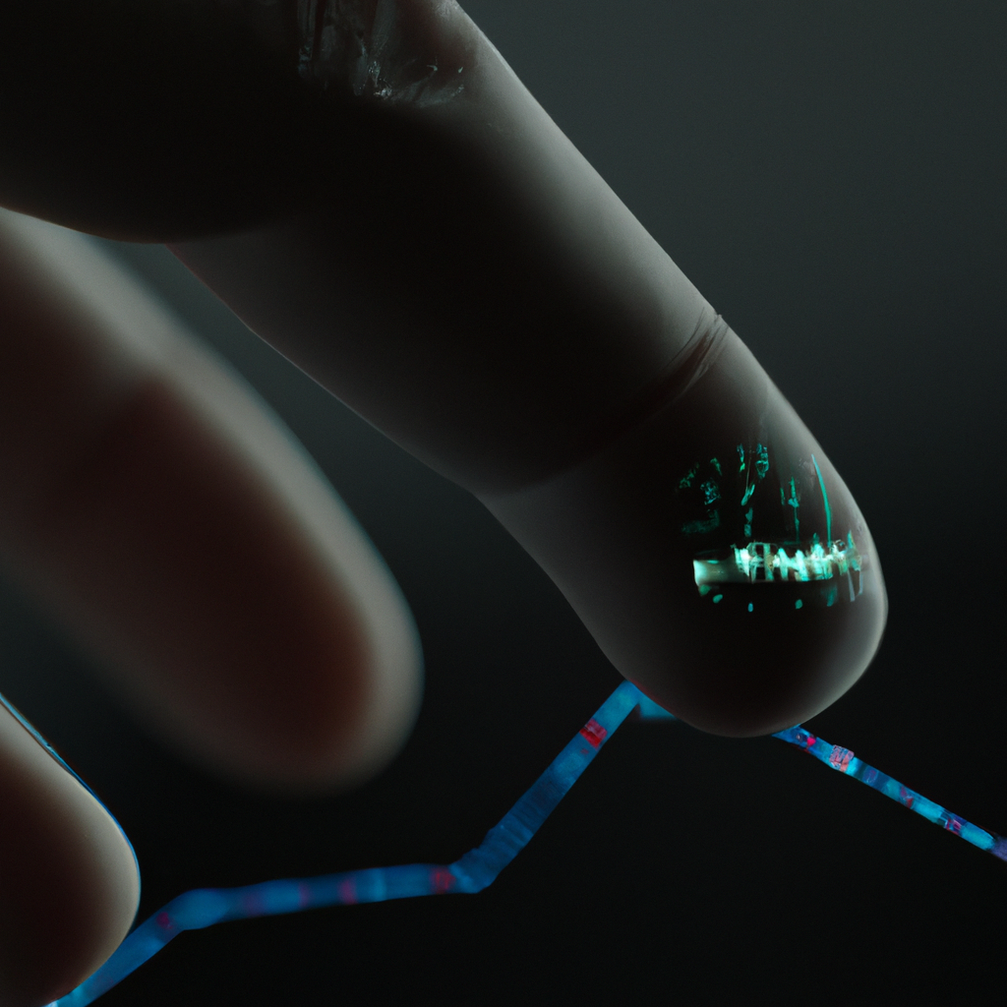
Problem statement
Frequent measurement and study of changes in blood flow could be used to improve the ability of health care providers to diagnose and treat patients with vascular conditions, such as those associated with diabetes and high blood pressure. Blood flow can be used to determine the tissue health. If we notice that blood flow is increased then there of chances of infection or inflammation and the flow is decreased then there might be chances of heart attack or low blood pressure. If there is less blood flow to the organs then diseases are inevitable.
Introduction

Slide 17
Scope Of Problem Statement

Slide 18

Scope Of Problem Statement
1. Data Collection and Preprocessing:
- Gather a diverse range of sensory data sources, including Doppler ultrasound readings, pressure measurements, and other vascular signals.
- Implement data preprocessing techniques to clean, normalize, and standardize the collected data.
- Address missing values, outliers, and noise to ensure the data's quality and reliability.
2. Feature Extraction and Engineering:
- Identify key features relevant to blood flow patterns and vascular health.
- Utilize signal processing techniques to extract meaningful attributes from the sensory data.
- Explore advanced feature engineering methods to capture intricate flow characteristics.
3. Algorithm Selection and Development:
- Evaluate various machine learning algorithms suitable for blood flow analysis, including Random Forest, Support Vector Machines, and neural networks.
- Develop predictive models capable of learning patterns from the extracted features.
- Implement an ensemble of algorithms to enhance accuracy and robustness.
4. Anomaly Detection and Classification:
- Train models to distinguish between normal and abnormal blood flow patterns.
- Implement anomaly detection mechanisms to identify flow irregularities.
- Classify different types of vascular conditions based on the sensory data.
Introduction

Slide 19
Scope Of Problem Statement
5. Real-time Monitoring and Visualization:
- Design a real-time monitoring system capable of processing and analyzing sensory data streams.
- Develop interactive dashboards and visualizations for healthcare professionals to monitor blood flow patterns.
- Incorporate real-time alerts for rapid response to critical flow anomalies.
6. Performance Evaluation and Validation:
- Define appropriate performance metrics to assess the accuracy and reliability of the developed models.
- Conduct thorough cross-validation to validate the models' generalization capabilities.
- Fine-tune hyperparameters to optimize model performance and avoid overfitting.
7. Clinical Integration and Interpretability:
- Collaborate with medical experts to ensure the system's relevance to clinical contexts.
- Generate interpretable feature importance rankings and visual explanations for model predictions.
- Facilitate easy integration of the system into existing clinical workflows.
8. Continuous Improvement and Adaptation:
- Establish a feedback loop with healthcare practitioners to gather insights and refine the system's performance.
- Implement mechanisms for model retraining and adaptation to evolving patient conditions.
- Ensure scalability to accommodate increasing data volume and new sources of sensory data.
Introduction

Slide 20

Software/Hardware
Requirements

Slide 21

Software Requirements
1. Data Integration and Preprocessing:
- Collect and preprocess sensory data (ultrasound, pressure, etc.) for analysis.
- Implement data cleansing, noise reduction, and missing value handling.
2. Feature Extraction:
- Identify relevant features (velocity, waveform attributes) from raw sensory data.
- Apply signal processing techniques for feature extraction.
3. Algorithm Development:
- Create machine learning models (Random Forest, SVM) for blood flow analysis.
- Develop algorithms for anomaly detection and classification.
4. Real-time Processing and Monitoring:
- Enable real-time processing of streaming sensory data.
- Design interactive dashboards for real-time blood flow pattern monitoring.
5. Performance Assessment:
- Define accuracy metrics for model evaluation.
- Conduct cross-validation to validate and optimize model performance.
Introduction

Slide 22
Software Requirements
6. Clinical Integration:
- Ensure seamless integration into clinical workflows.
- Provide feature importance insights for model predictions.
7. Alert Mechanism:
- Implement real-time alerts for critical flow anomalies.
- Allow immediate response to urgent situations.
8. Adaptation and Scalability:
- Incorporate model retraining mechanisms for changing conditions.
- Design system to handle increased data load and scale effectively.
9. User Access and Data Security:
- Implement secure user authentication and authorization.
- Comply with data privacy regulations for secure data handling.
10. Reporting and Analytics:
- Generate comprehensive reports on blood flow patterns and anomalies.
- Provide trend analysis and actionable insights.
Introduction

Slide 23
Hardware Requirements
1. Sensors and Data Sources:
- Compatible Doppler ultrasound devices for blood flow data capture.
- Pressure sensors for accurate pressure measurements.
- Necessary connectors and interfaces for data input.
2. Computing Infrastructure:
- High-performance servers or cloud resources for real-time data processing.
- Multi-core processors and sufficient RAM for efficient model computation.
3. Storage Solutions:
- Adequate storage capacity for storing sensory data streams and processed results.
- Fast storage mediums (SSD) for quick data retrieval and processing.
4. Networking and Connectivity:
- Stable high-speed internet connectivity for real-time data streaming.
- Network equipment with low latency and minimal downtime.
Introduction

Slide 24
Hardware Requirements
5. Display and Visualization:
- High-resolution monitors for displaying real-time dashboards and visualizations.
- Compatible graphics cards for rendering interactive data displays.
6. Security Measures:
- Secure firewalls and intrusion detection systems to protect data.
- Encryption mechanisms for data transmission and storage.
7. Backup and Redundancy:
- Regular automated backup solutions for data protection.
- Redundant hardware components to minimize downtime.
8. User Devices:
- Desktop or laptop computers with modern web browsers for accessing the monitoring system.
- Mobile devices with compatible apps for remote access.
Introduction

Slide 25

Functional & Non Functional Requirements.

Slide 26

Functional Requirements.
1. Data Handling:
- Collect and preprocess sensory data from various sources like Doppler ultrasound and pressure sensors.
- Cleanse data by removing noise and handling missing values.
2. Feature Extraction:
- Identify essential features from the sensory data, such as velocity profiles and waveform attributes.
- Use signal processing techniques to extract informative attributes.
3. Model Development:
- Build machine learning models (e.g., Random Forest, SVM) to analyze blood flow patterns.
- Develop algorithms for anomaly detection and classification.
4. Real-time Monitoring:
- Enable real-time processing and analysis of sensory data streams.
- Create interactive dashboards for healthcare professionals to monitor blood flow patterns.
5. Performance Evaluation:
- Define accuracy metrics to assess model effectiveness.
- Conduct cross-validation for validation and optimization.
Introduction

Slide 27
Functional Requirements.
6. Clinical Integration:
- Ensure easy integration into clinical workflows.
- Generate feature importance rankings for model predictions' interpretability.
7. Alerting Mechanism:
- Provide real-time alerts for critical flow anomalies.
- Enable timely response to urgent situations.
8. Adaptation and Scaling:
- Implement mechanisms for model retraining based on changing conditions.
- Design for scalability to handle increased data volume.
9. User Access and Privacy:
- Secure user access through authentication.
- Comply with data privacy regulations and ensure data protection.
10. Reporting and Analytics:
- Generate comprehensive reports on blood flow patterns.
- Provide analytics for trend analysis and insights.
Introduction

Slide 28
Non Functional Requirements
1. Performance:
- Process data in milliseconds for prompt response.
- Handle high data volume without significant performance degradation.
2. Accuracy and Reliability:
- Achieve over 95% accuracy in blood flow pattern detection.
- Ensure consistent and reliable results across different data sources.
3. Scalability:
- Scale vertically and horizontally to accommodate increased data and user load.
- Handle concurrent requests without compromising performance.
4. Security:
- Implement strong encryption for data protection.
- Ensure robust authentication and authorization mechanisms.
5. Privacy and Compliance:
- Adhere to data protection regulations (e.g., GDPR, HIPAA).
- Provide data anonymization and secure retention policies.
Introduction

Slide 29
Non Functional Requirements
6. Usability and User Experience:
- Offer an intuitive and user-friendly interface.
- Present information clearly through effective visualizations.
7. Interpretability:
- Ensure model predictions are interpretable.
- Explain feature contributions to predictions.
8. Availability and Uptime:
- Maintain high availability with over 99.9% uptime.
- Incorporate failover mechanisms for minimal downtime.
9. Compatibility:
- Support various sensory data sources and formats.
- Integrate with existing hospital systems.
10. Maintainability:
- Maintain well-structured, documented code.
- Allow for seamless updates and patches.
Introduction

Slide 30
Description Of Models

Slide 31

Description Of Models
Blood flow detection is the process of measuring the movement of blood within the body. It is an important diagnostic tool that can help detect various medical conditions, such as blockages, narrowing of blood vessels, and blood clots.
There are different methods used for blood flow detection, including:
Ultrasound: This technique uses high-frequency sound waves to produce images of blood vessels and measure the speed and direction of blood flow. Ultrasound is commonly used to detect blood flow in the heart, arteries, and veins.
Magnetic Resonance Imaging (MRI): MRI uses a magnetic field and radio waves to produce detailed images of blood vessels and measure blood flow. MRI is often used to detect blood flow in the brain, heart, and other organs.
Computed Tomography (CT): CT scans use X-rays to produce detailed images of blood vessels and measure blood flow. CT scans are commonly used to detect blood flow in the lungs, abdomen, and pelvis.
Angiography: This technique involves injecting a contrast dye into the blood vessels and taking X-ray images to detect blood flow. Angiography is often used to detect blood flow in the heart, brain, and limbs.
Introduction

Slide 32
Description Of Models
Mathematical models of blood flow in the body use mathematical equations that describe the behavior of fluid dynamics to simulate blood flow in the circulatory system. These models can take into account various factors that affect blood flow, such as vessel geometry, viscosity, and turbulence. Mathematical models can be used to simulate blood flow under different physiological conditions, such as exercise, and can help predict the outcomes of various interventions, such as angioplasty or bypass surgery. They can also be used to study the development of vascular diseases and identify potential treatment strategies.
Machine learning models: Machine learning models for blood flow detection use algorithms to analyze data and identify patterns that can be used to make predictions about blood flow in different parts of the body. These models can be trained on large datasets of blood flow measurements, such as those obtained from ultrasound or MRI scans. Machine learning models can help detect anomalies in blood flow patterns that may indicate the presence of disease, such as stenosis or occlusion. They can also be used to predict the outcomes of various interventions, such as thrombolysis or stent placement.
Introduction

Slide 33

Description Of Models
Computational fluid dynamics (CFD) models: CFD models simulate blood flow in the body using computational methods. These models can take into account various factors that affect blood flow, such as vessel geometry, blood viscosity, and flow rates. CFD models can provide detailed information about blood flow patterns, pressure gradients, and shear stresses, which can help predict the outcomes of various interventions, such as stent placement or bypass surgery. CFD models are often used in the design of medical devices, such as artificial heart valves, and in the optimization of surgical procedures, such as angioplasty.
Statistical models: Statistical models use statistical methods to analyze data and identify patterns in blood flow measurements. These models can be used to develop predictive models of blood flow in different parts of the body and to identify factors that may contribute to the development of vascular diseases. For example, statistical models can be used to identify risk factors for atherosclerosis or to predict the likelihood of stroke in patients with carotid artery disease.
Introduction

Slide 34
Description Of Models
Blood flow detection can help diagnose a wide range of medical conditions, including peripheral artery disease, deep vein thrombosis, stroke, and heart disease. It can also help monitor the effectiveness of treatments and guide surgical procedures.
Overall, the use of models for blood flow detection can provide valuable insights into the complex dynamics of blood flow in the body. These models can help healthcare providers make informed decisions about patient care, develop new treatments, and design medical devices and procedures that are more effective and less invasive.
Introduction

Slide 35

Work Done So Far

Slide 36

Work Done So Far
import pandas as pd
from sklearn.ensemble import RandomForestClassifier
from sklearn.model_selection import train_test_split
from sklearn.metrics import accuracy_score
data = pd.read_csv('blood_flow_data.csv')
X = data.iloc[:, :-1]
y = data.iloc[:, -1]
X_train, X_test, y_train, y_test = train_test_split(X, y, test_size=0.2, random_state=42)
classifier = RandomForestClassifier(n_estimators=100, random_state=42)
classifier.fit(X_train, y_train)
y_pred = classifier.predict(X_test)
accuracy = accuracy_score(y_test, y_pred)
print('Accuracy:', accuracy)
new_data = pd.DataFrame([[0.3, 0.4, 0.6]], columns=['x', 'y', 'z'])
prediction = classifier.predict(new_data)
print('Prediction:', prediction)
Introduction

Slide 37
Work Done So Far
Output :
x,y,z,category
0.2,0.4,0.5,normal
0.3,0.5,0.4,normal
0.4,0.3,0.6,normal
0.5,0.4,0.7,abnormal
0.6,0.3,0.5,abnormal
0.4,0.2,0.3,abnormal
0.3,0.4,0.6,normal
0.5,0.6,0.4,normal
0.6,0.5,0.7,abnormal
0.2,0.3,0.5,normal
Introduction

Slide 38

Individual Contribution

Slide 39
Individual Contribution
21881A66C0 – T.YUGENDHAR NAIDU : Literature survey
21881A66C6 – V.VENKATESH BABU : Power point presentation
21881A66C9 – Y.SAI KRISHNA : Information gathering & paper collection
21881A66A2 – MD ASRAR HUSSAIN : Gathered information about description of models.
Introduction

Slide 40

References

Slide 41

References
E.J. Benjamin, M.J. Blaha, S.E. Chiuve, M. Cushman, S.R. Das, R. Deo, , Heart Disease and Stroke Statistics-2017 Update: A Report From the American Heart Association, Circulation 135(10) (2017) e146-e603.
https://www.ncbi.nlm.nih.gov/pubmed/28122885.Google ScholarM. Writing Group, D. Mozaffarian, E.J. Benjamin, A.S. Go, D.K. Arnett, M.J. Blaha, , Executive Summary: Heart Disease and Stroke Statistics–2016 Update: A Report From the American Heart Association, Circulation 133(4) (2016) 447-54.
https://www.ncbi.nlm.nih.gov/pubmed/26811276.Google ScholarS. Cook, M. Togni, M.C. Schaub, P. Wenaweser, O.M. Hess, High heart rate: a cardiovascular risk factor?, Eur Heart J 27(20) (2006) 2387-93.
https://www.ncbi.nlm.nih.gov/pubmed/17000632.Google ScholarCross Ref
Introduction

